Slide 1
ISTQB Foundation
ISTQB Foundation

Slide 2

Agenda
Fundamentals of Testing
Testing Through the SDLC
Static/Dynamic Testing
Test Techniques
Test Management
Tools
ISTQB Foundation

Slide 3
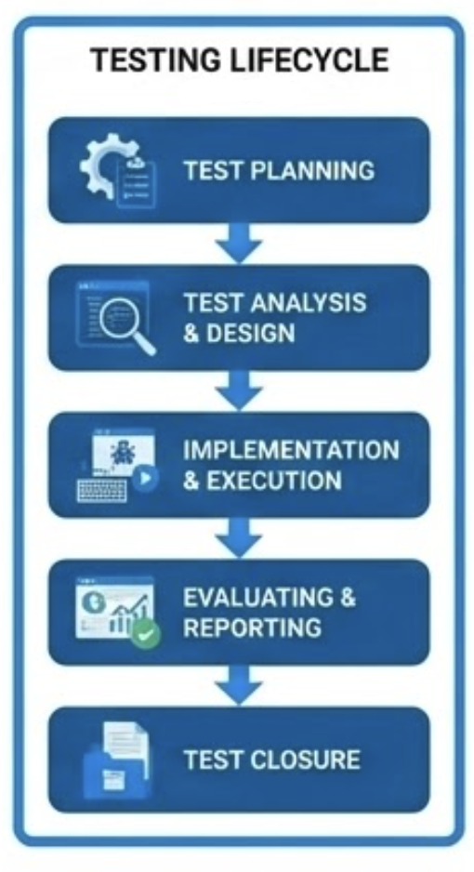
Fundamentals of Testing
Why Testing is Needed?
Test Activities
Identify bugs and improvement points
Reduce risk
Increase quality
Satisfy market and customer needs
Test planning: Defining objectives and areas to be test
Test analysis: Going through documents, discussions and groomings. In this phase also test scenarios can be created and defined which automation framework can be used for which scenarios
Test implementation: Executing the planned test scenarios. Also bugs, improvement tickets would be created during this process.
Reporting: Aligning with product and development team about the result of execution
ISTQB Foundation | Fundamentals of Testing

Slide 4
Testing Through the SDLC
Aligning SDLC Models
TDD (Test Driven Development)
ATDD (Acceptance Test-Driven Development)
Agile: The modal which is more based on iterations and results which helps to make decisions
Waterfall: The modal which has predefined all the business cases and possible scenarios before development starts
Test based development life cycle. Test automations, unit tests are written first then actual development starts
Pros: Better code quality – Easier to debug
Cons: Time management – Limited unit tests
A collaboration-based test-first approach, tests and scopes created during grooming, but most of main executable test codes will be provide after actual development finish. Tests are derived from the acceptance criteria of user stories.
Pros: Clear acceptance criterias – More alignment on businesses, devs, QAs, product
Cons: Challenging requirements – Need good colabilariation
ISTQB Foundation | Testing Through the SDLC

Slide 5
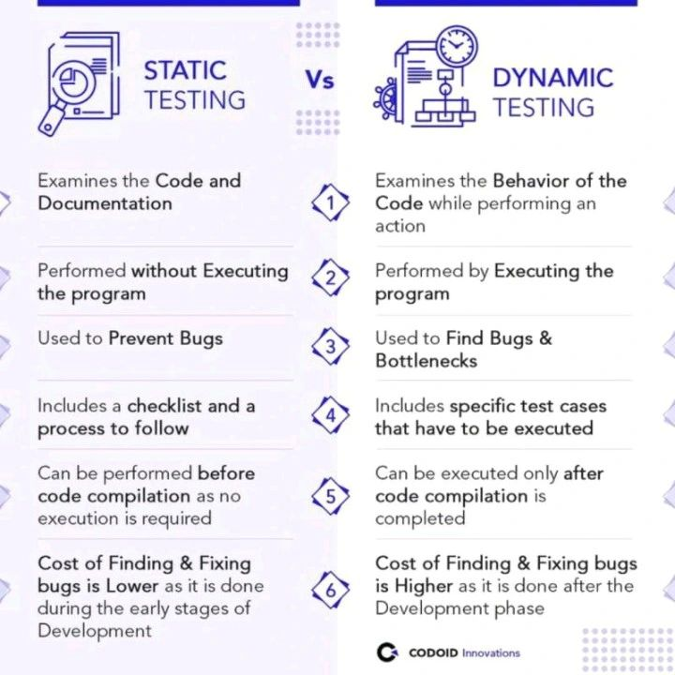
Static/Dynamic Testing
Static Testing
Dynamic Testing
Testing effort that performs without executing any testing or coding. This is for defining possible breakpoints, risky areas. This will perform early stage of development.
Testing effort that performs and execute test scenarios automations, defines bug based on results. More costly than static testing because defects can be only found after its developed.
ISTQB Foundation | Static/Dynamic Testing

Slide 6
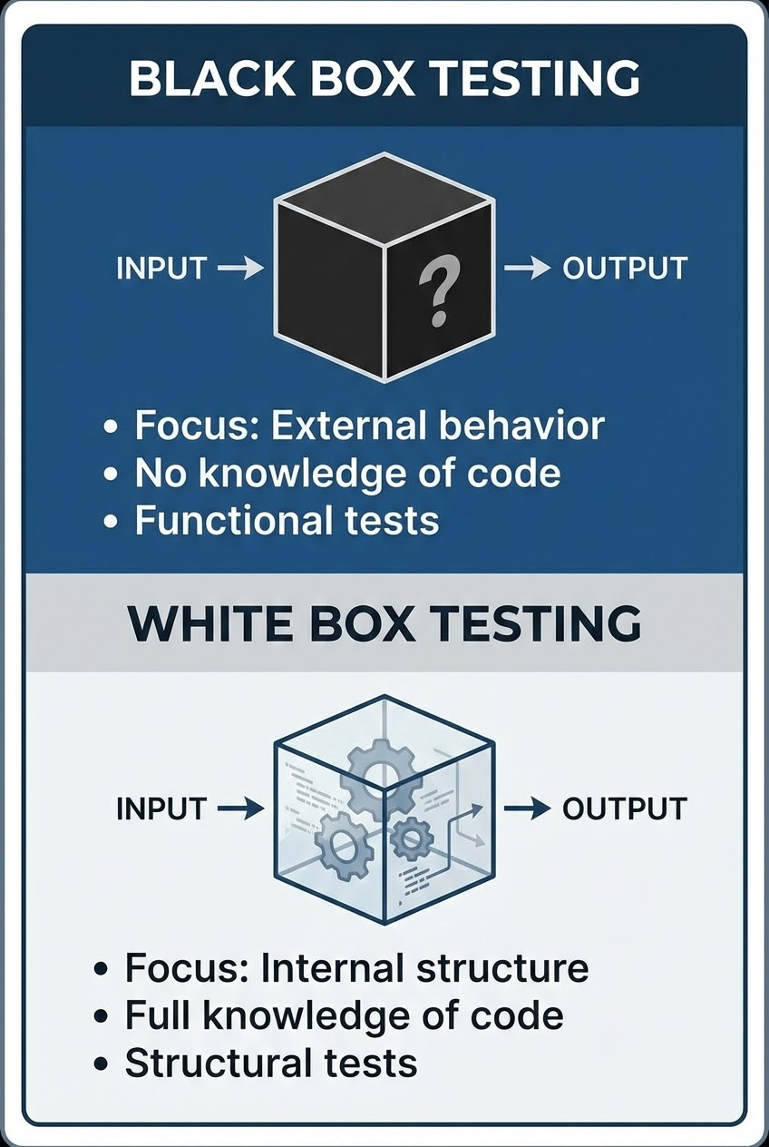
Test Techniques
Black Box Testing
White Box Testing
Testing the functionality without checking internal structure. This testing will be focusing on input/output relation but would not consider ‘how’?
Equivalence Partitioning
Boundary Value Analysis
Decision Table Testing
State Transition Testing
Use Case Testing
"Structure-based" testing that are testing the product from internal software, not just its external behavior.
Statement Coverage
Branch Coverage
Path Coverage
ISTQB Foundation | Test Techniques

Slide 7
Test Management
Test Planning
Estimating Test Efforts
Modeling Test Types
Risk Analysis
Defect and Configurations
Tracking Process
Definition of Ready and Definition of Done is created for Agile teams
Test case prioritization
Dependencies and availability of resources
Extrapolation: Having better estimations based on iterations
Wideband Delphi: Discussing estimations between different experiences experts
Three-point Estimation: Having average of most optimistic-most likely-most pessimistic estimates
Test pyramid
Different variants of test types will be available for project
Defining automation framework for created test scenarios
Project Risks: Related to management of project. Such as: Delayed releases, running over budgets etc..
Product Risks: Related to product quality. Such as: high maintenance costs, reputational damage
Perform regression test, applying performance, security testing, correct assignments
Reporting issues, improvement points has been found during testing
Report should have: title, summary, steps to reproduce, expected and actual information. As well as screenshot or screen recording.
Reprioritization test cases based on defects
Tracking test items and testware throughout the lifecycle
Identifying necessary skills within the team and developing those skills
Reporting to the current audiences
ISTQB Foundation | Test Management

Slide 8
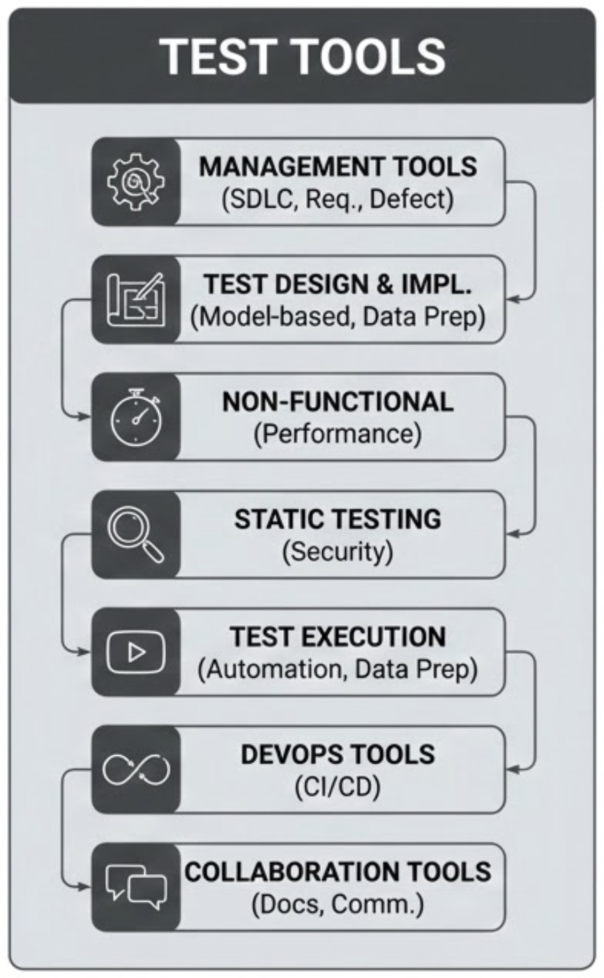
Test Tools
Management Tools
  SDLC
  Requirement management
  Defect management
Test Design and Implementation Tools
  Model based testing tools such as (mocker, charles etc..)
  Test data preparation
Non Functional testing Tools
  Performance testing tools
Static Testing Tools
  Security testing tools
Test Execution Tools
  Tools to generate test cases, assist test automation, identify gaps in requirements
  Data preparation tools
Devops Tools
  Continuous Integrations
Collaboration Tools
  Documentation, communication tools like confluence, slack
ISTQB Foundation | Test Tools

Slide 9
Thank you!
ISTQB Foundation

